Slide 1
create education product for children
Product Name: Play & Grow
Category
Early Learning Educational Kit (Ages 4–8)
Core Idea
Play & Grow is a hands-on, screen-light learning kit that helps children learn thinking, language, numbers, emotions, and creativity through play. The product is modular, meaning children learn without pressure and at their own pace.
What the Product Includes
1. Story-Based Learning Cards
Short illustrated stories
Each story teaches:
Moral reasoning
Basic math or language concepts
Emotional awareness
🧠 Psychology: Stories improve memory retention and empathy.

Slide 2
2. Activity Boards (Reusable) Velcro / magnetic boards Tasks like: Match shapes Build sequences Solve simple puzzles 🧠 Why it works: Improves problem-solving and fine motor skills. 3. Emotion & Expression Cards Faces showing different emotions Children identify, name, and talk about feelings 🧠 Builds emotional intelligence, often ignored in early education. 4. Creative Play Pack Drawing prompts Build-your-own story sheets DIY craft ideas 🧠 Encourages imagination instead of rote learning. Learning Outcomes ✔ Cognitive skills ✔ Emotional intelligence ✔ Language development ✔ Confidence & independence ✔ Creativity
Parent & Teacher Friendly
Simple guidebook with:
How to use activities
Progress tips (no tests)
Can be used at home or in classrooms
Design & Colors (Child Psychology Based)
Primary palette: Soft blue & warm yellow (calming + focus)
Accent: Coral (engagement, happiness)
Rounded shapes, friendly illustrations, no sharp visuals
Why This Product Is Different
No pressure
No heavy screens
Learning through doing, feeling, and creating
Suitable for different learning speeds

Slide 3
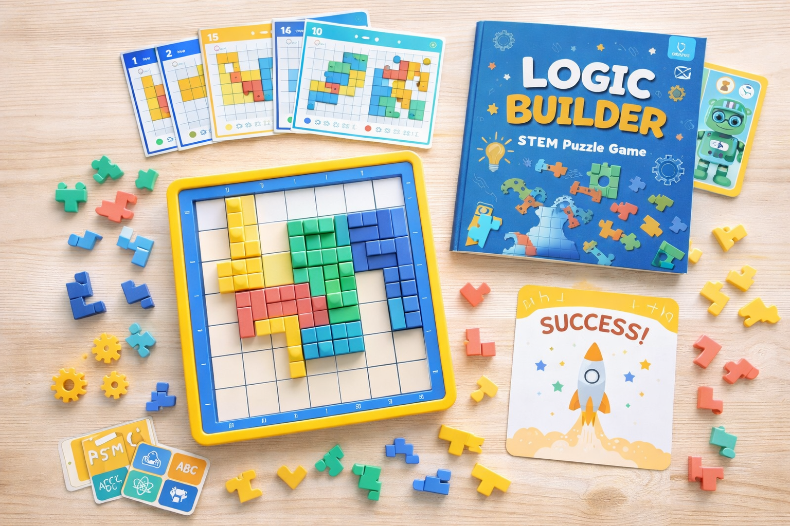
PROMPT 2-create one educational toy for children between the age of 7-10yrs, show it visually

Slide 4
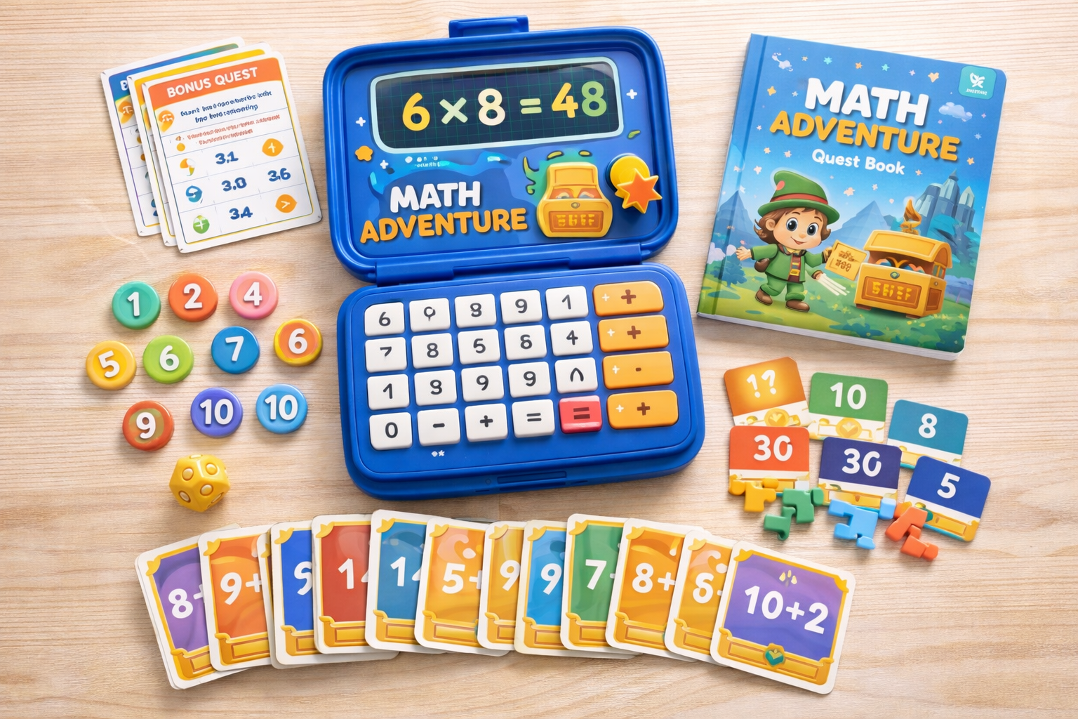
PROMPT 3- create one educational toy for children between the age of 7-10yrs, show it visually.The toy should be able to make them love numbers, love maths. It should be a small product toy/game easy to handle

Slide 5
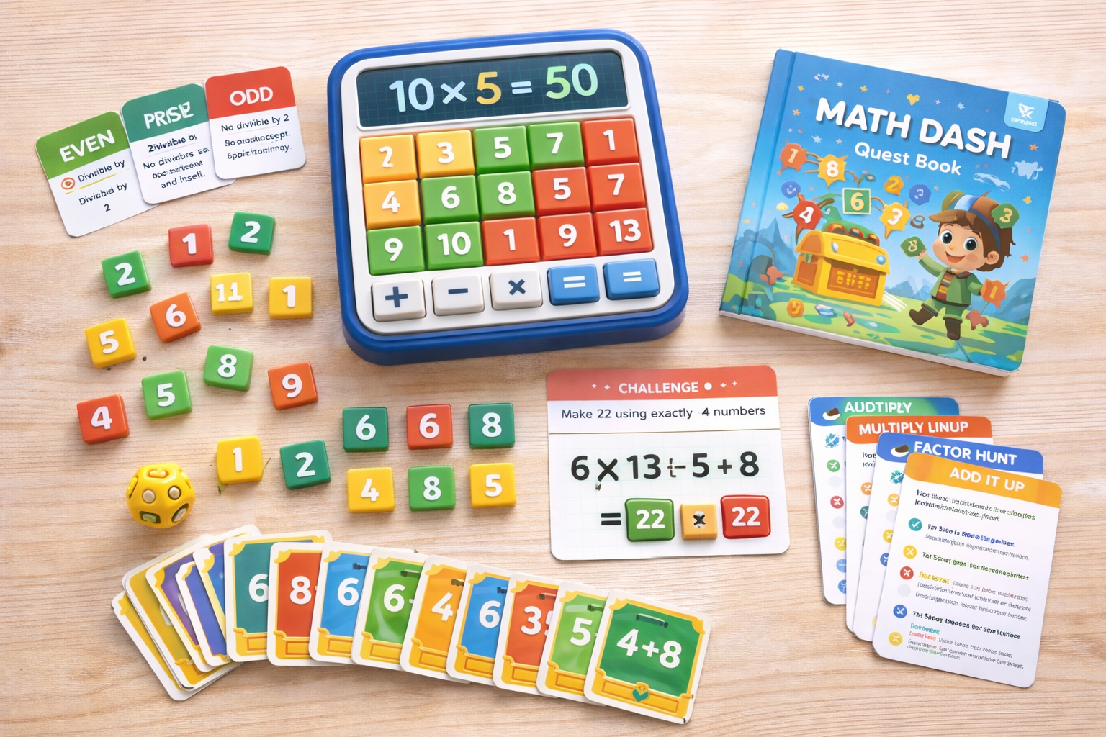
PROMPT 4- create one educational toy for children between the age of 7-10yrs, show it visually.The toy should be able to make them love numbers, love maths. It should be a small product toy/game easy to handle.The product should be color coded to understand better, prime numbers as yellow, even as green, odd as red. It should teach mathematical calculations as well

